Slide 1
Group 2

Slide 2
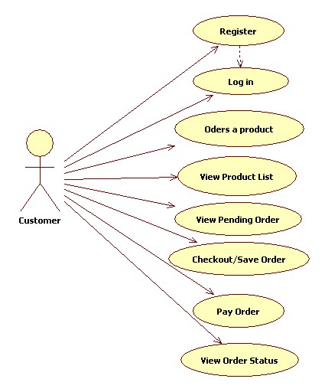
UML Diagram: Usecase Diagram

Slide 3
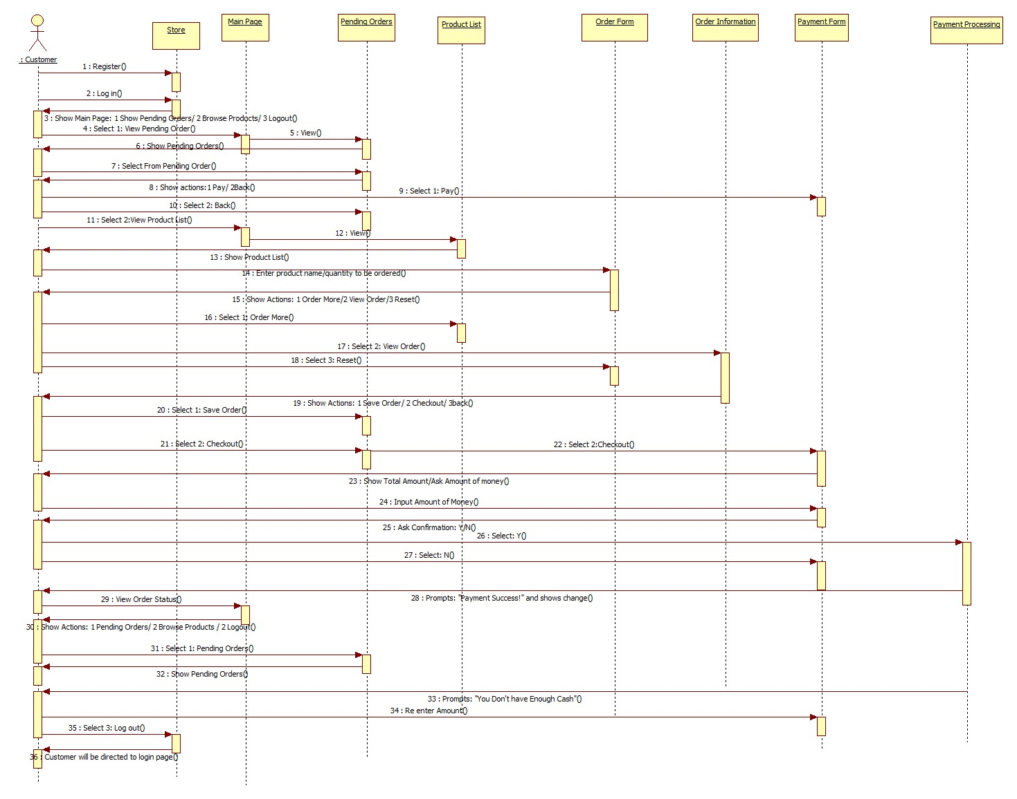
UML Diagram: Sequence Diagram

Slide 4
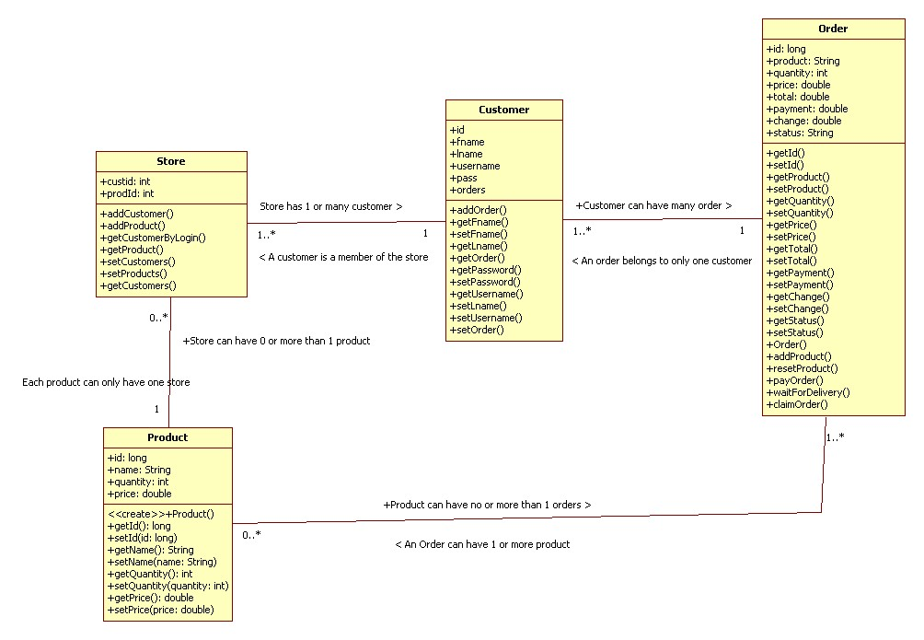
UML Diagram: Class Diagram

Slide 5
Program Flow
1. Customer
Register Account
Log-In Account
2. Main Menu
Pending Order
Browse Products
Logout

Slide 6
Program Flow
3. Pending Order
Order Committed
Delivery out of storage
Ready to receive product for user
2. Browse Product
Product list
3. Product List
Product ID
Quantity

Slide 7
Program Flow
4. Product List menu
Order more
View Order
Reset
Back
5. View Order
Pending Order
6. Pending Order
Order Committed - Checkout – Payment Success
Delivery out of storage – Ready to receive product for user

Slide 8
Contributions
Ziggy Flameno –Transaction, Base classes, Checkout
Lance Lopez – Main menu, Pending Order
Kassandra Fuentes – Customer register, Log-In
Danna Soquiat – UML Diagram
William Kalingasan - Order (View Order, Product list)
Meynard Denoyo – Order (View Order, Product list)

